Slide 1
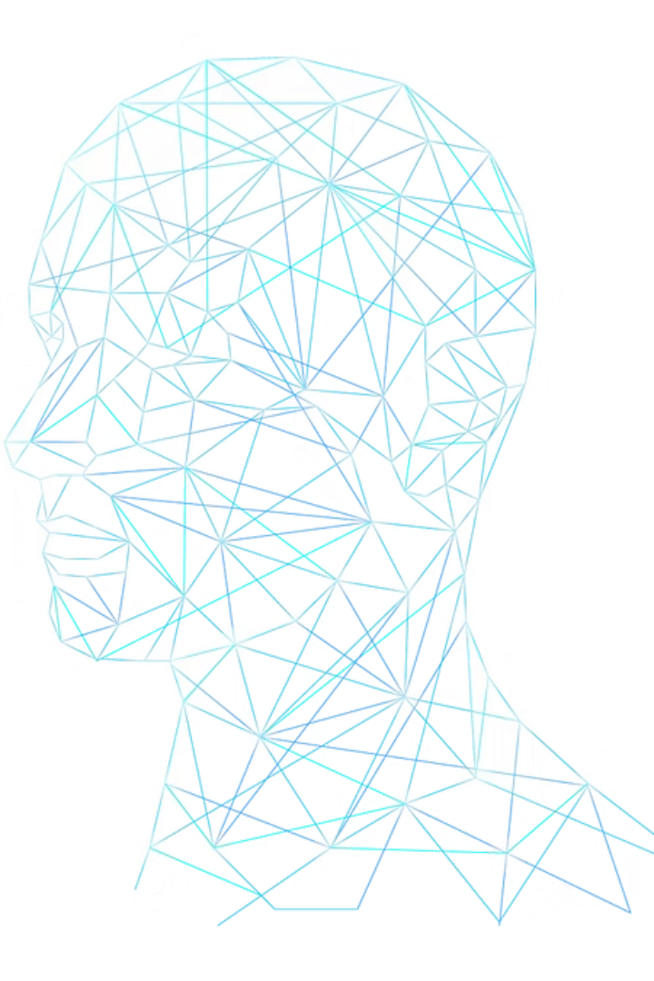
Analyzing Micro-Expressions for Lie Detection using Computer Vision
Group: AI & DS 6
Sub-Group: 7

Slide 2

Team Members
Pritanshu Kumar Mallick CL2025010601911753
Pratik Mohanty CL20250106018939121
Om Prakash Behera CL2025010601945230

Slide 3

CONTENTS
01
02
03
04
Introduction
Dataset Overview
Tools & Libraries Used
Model Building
05
06
07
08
Current Model vs Traditional Model
Challenges Faced
Future Scope
Conclusion

Slide 4
Introduction
In an age where truth and deception can have significant consequences—be it in security, law enforcement, or interpersonal communication—understanding human expressions has never been more critical. Micro-expressions, which are brief, involuntary facial expressions that occur in high-stakes situations, offer a window into a person's true emotions. These expressions often reveal hidden feelings and are difficult to control, making them a valuable resource for detecting deception.
This project explores the use of computer vision and deep learning to automatically analyze micro-expressions and distinguish between truthful and deceptive behavior. By combining convolutional neural networks (CNNs) to capture spatial facial features and Long Short-Term Memory (LSTM) networks to understand temporal changes across video frames, we aim to build a robust system for lie detection.

Slide 5
Data Overview
Dataset & Preprocessing
Overview of the dataset and steps taken to prepare it for analysis.
Dataset
Source: Micro Expression Dataset for Lie Detection from Kaggle.
Content: Facial images labeled as either 'lie' or 'truth'.
Image Processing
Resized all images to a uniform 128×128 pixels.
Normalized pixel values to ensure consistency for the model.
Data Augmentation Techniques
Applied rotation to diversify image angles.
Used horizontal flip to create mirror images.
Incorporated zoom for varied perspectives.
Adjusted width and height shift for additional variation.
Validation Split:
Allocated 15% of the data for validation, 15% to test & 70% to training purposes.
Helps prevent overfitting and ensures model generalization.

Slide 6
Tools & Libraries used
Core Libraries:
numpy: Fundamental package for fast numerical computing with arrays and matrices.
pandas: Powerful library for data manipulation and analysis using DataFrames.
matplotlib: Versatile plotting library for creating static, animated, and interactive visualizations.
seaborn: Statistical data visualization library built on top of matplotlib with a high-level API.
Computer Vision & Imaging:
opencv-python: OpenCV library for real-time computer vision and image processing tasks.
pillow: Python Imaging Library (PIL) fork for opening, manipulating, and saving image files.
imgaug: Library for performing image augmentation for machine learning experiments.
mediapipe: Google's framework for building pipelines for face, hand, and pose tracking in real-time.
Machine Learning & Deep Learning:
tensorflow: End-to-end open-source platform for machine learning and deep learning model development.
scikit-learn: Widely-used library for classical machine learning algorithms and tools.
keras-tuner: Hyperparameter tuning framework for optimizing Keras models automatically.
visualkeras: Library to visualize Keras model architecture as clean and simple layer diagrams.
Deployment & Apps:
streamlit: Lightweight Python framework to build interactive web apps for ML and data projects.

Slide 7
Model Building
Hybrid CNN + LSTM Model: Combining spatial and temporal feature extraction for sequence-based predictions
The CNN+LSTM hybrid model is a deep learning architecture that integrates Convolutional Neural Networks (CNNs) and Long Short-Term Memory (LSTM) networks to process data that has both spatial and temporal dimensions — like video frames, micro-expressions, gesture recognition, or sensor readings over time.
How It Works:
1
CNN (Convolutional Neural Network):
2
LSTM (Long Short-Term Memory):
3
Dense Layer:
- Final layer to classify the entire sequence (e.g., "truth" or "lie").
- Extracts spatial features from each individual frame (image).
- Processes the sequence of extracted features from CNNs.
- Learns patterns like edges, textures, and regions of interest.
- Learns temporal dependencies across frames.
- Operates frame-by-frame using TimeDistributed layers.
- Ideal for time-based data like facial expressions, gestures, etc.

Slide 8
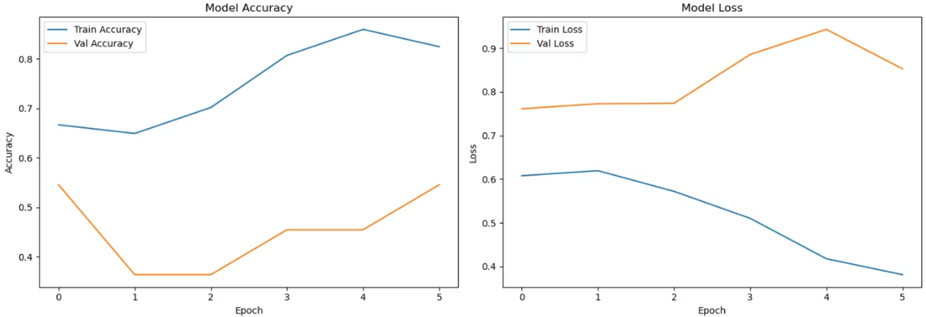
Model Metrics Summary

Slide 9

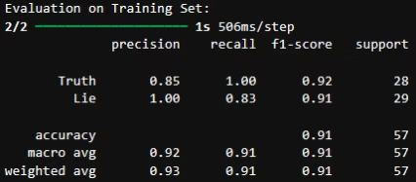
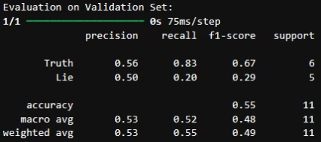
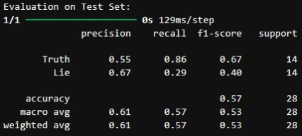
Dataset
Accuracy
'Truth' F1-Score
'Lie' F1-Score
Remarks
Training
91%
0.92
0.91
Excellent fit on training data
Validation
55%
0.67
0.29
Still low recall for 'Lie'
Test
57%
0.67
0.40
Some improvement in 'Lie' detection
Insights:
Class weighting helped the model better recognize the 'Lie' class in the test set (recall ↑ from 0.07 → 0.29).
There's still a gap in generalization to unseen data (test/validation).
Might indicate:
Not enough temporal diversity in training sequences
Potential for model enhancement or fine-tuning (architecture, regularization, data augmentations).

Slide 10
Current Model vs. Tradition Model
Here, Current Model = Hybrid(CNN+LSTM) & Traditional Model = Random Forest Classifier
Feature
Traditional (RandomForestClassifier)
CNN + LSTM
Architecture
Shallow ML model (e.g., SVM, Logistic Regression, Random Forest)
Deep learning model combining CNN and LSTM
Input
Predefined features (e.g., facial landmarks, handcrafted features, pixel intensities)
Raw image sequences (e.g., frame-wise facial images)
Learning
Feature-based learning, not end-to-end
End-to-end learning — extracts spatial + temporal patterns automatically
Temporal Modeling
Usually ignores temporal (time-based) dependencies
LSTM captures temporal dependencies across frames
Performance
Decent, but limited by feature quality and inability to handle raw data
Often superior, especially on large datasets with complex patterns
Explainability
Often easier to interpret
More complex to interpret without visualization tools

Slide 11
Challenges Faced
Challenges in Capturing Micro-Expressions
Subtlety of Micro-Expressions: Micro-expressions last for less than half a second and are often subtle and involuntary. Capturing these fleeting cues requires high temporal resolution and sensitivity, making detection challenging even for advanced vision models.
Limited Data Availability: High-quality datasets of micro-expressions labeled for truthful and deceptive behavior are rare. Most datasets are small, not standardized, and often lack diversity in ethnicity, age, and gender—leading to potential bias in model training.
Noisy Real-World Conditions: Variations in lighting, head poses, occlusions (e.g., glasses or facial hair), and camera quality introduce noise. These affect facial landmark detection and the accuracy of the extracted features.
Technical Modeling and Integration Challenges
Temporal Dynamics Extraction: Modeling the motion of facial muscles over time is complex. Optical flow techniques like Farneback help, but they require careful tuning and pre-processing to avoid overfitting or underfitting.
Model Selection and Integration: Choosing between CNNs, RNNs, or hybrid models (like CNN-LSTM) requires balancing accuracy, complexity, and interpretability. Integration with real-time systems (e.g., webcam input + speech recognition) adds another layer of difficulty.
Audio-Visual Synchronization: Combining facial cues with speech features (e.g., tone, pause, stammering) for multi-modal analysis requires precise synchronization, which is often hard to achieve in real-time settings.
Data and Generalization Issues
Ground Truth Label Ambiguity: Determining whether a person is truly lying is not always straightforward—many datasets rely on controlled environments or self-reported truths, which may not reflect real-world deception accurately.
Model Generalization: Ensuring that the model generalizes well to new individuals, accents, and environments is difficult. There's always a risk of overfitting to training data, especially when using small or synthetic datasets.

Slide 12
Future Scope
Expand Dataset
Multimodal Integration
Use larger, more diverse datasets with real-world scenarios to improve model generalization.
Incorporate additional inputs like voice, body posture, or physiological signals for more robust lie detection.
Real-Time Deployment
Model Interpretability
Optimize and deploy the model in real-time systems using edge computing or lightweight architectures like MobileNet + LSTM.
Integrate tools like Grad-CAM or SHAP to visualize and explain decision-making, increasing trust and transparency.
Transfer Learning
Fine-grained Emotion Detection
Explore pre-trained CNN backbones (e.g., ResNet, EfficientNet) to further improve spatial feature extraction.
Extend the model to classify fine-grained emotions that may be precursors to deception.

Slide 13
Conclusion
In this project, we successfully implemented a hybrid deep learning model combining Convolutional Neural Networks (CNNs) and Long Short-Term Memory (LSTM) networks to detect lies based on facial micro-expressions.
The CNN layers effectively captured spatial features from individual frames, while the LSTM layers modeled the temporal dynamics across sequences. Compared to traditional machine learning approaches, our hybrid model demonstrated superior performance by leveraging both spatial and temporal patterns inherent in micro-expression data.
This approach showcases the potential of deep learning in enhancing the accuracy and automation of deception detection systems.

